Slide 1
Maximizing Profit in
E-Commerce Sales
ADS 505
George Garcia, Summer Purschke, Vannesa Salazar

Slide 2
Executive Summary
Data
Problem
Goal
Resolution
Global Superstore:
Shipping, Customer, Product, Location and Sales information
Use predictive modeling to increase overall profit by selective re-sale of high profit products
-$247,843.40 in losses from poorly chosen products
Product replacement can recover $374,680 of lost profits

Slide 3
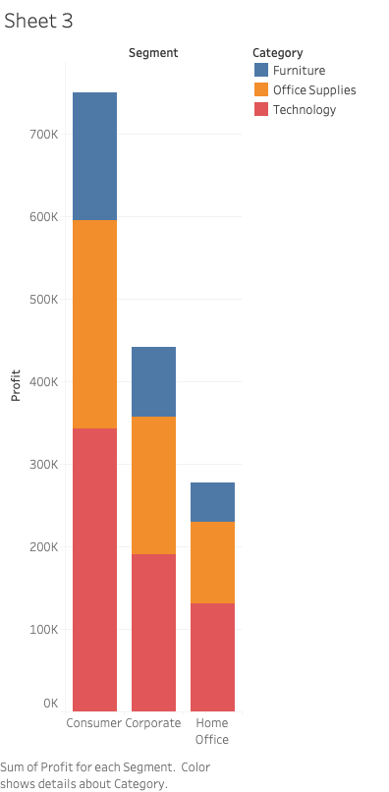
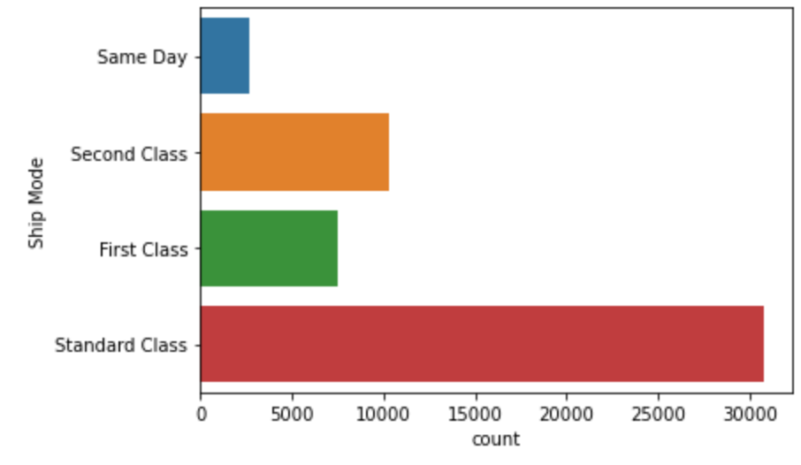
Exploration
Logistic Regression
Notes:
In our exploration for profitability we saw that people were buying office supplies and furniture with most of them using the standard class shipment to second class. This gave an idea on how we could increase profit by lowering cost of inventory and only having product that give a profit

Slide 4
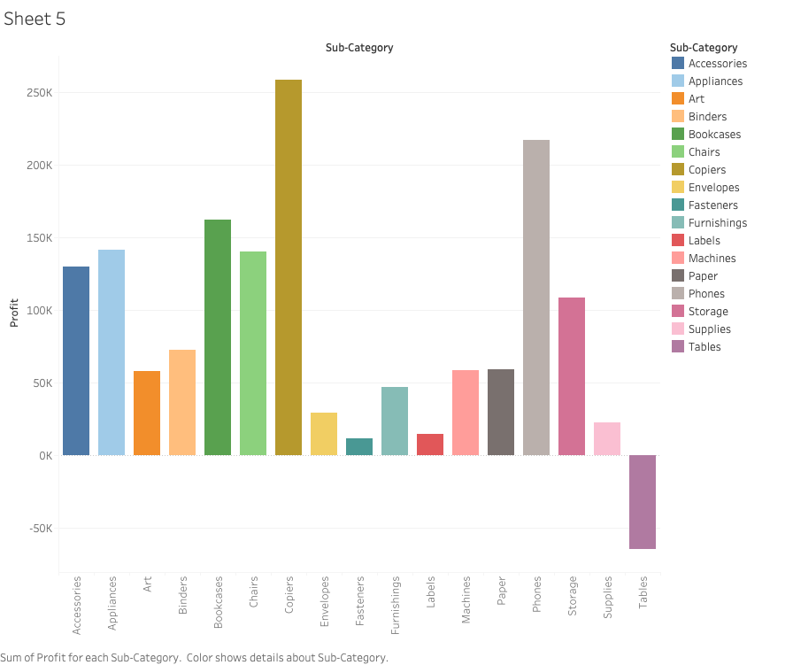
Purchase Category and Predicting Profitability
Notes:
This was able to be more cleared when looking at the sub categories of product and there profitable

Slide 5
Least Profitable Products
Products with low or negative profit margins have caused -$247,843.40 in total loss
Product replacement can recover $374,680 of lost profits
Selling Unpopular Products
Product | Profit
Cubify CubeX 3D Printer Double Head Print | -$8879.97
Lexmark MX611dhe Monochrome Laser Printer | -$4589.97
Motorola Smart Phone, Cordless | -$4447.04
Cubify CubeX 3D Printer Triple Head Print | -$3839.99
Bevis Round Table, Adjustable Height | -$3649.89

Slide 6
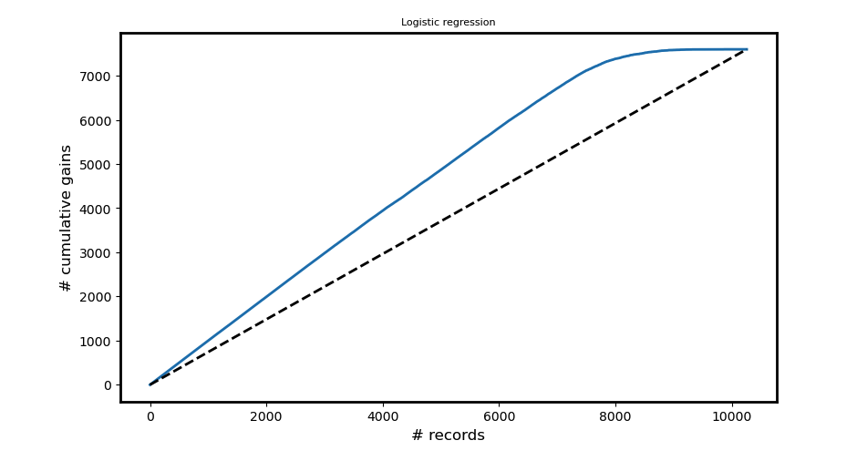
Deriving Insight
Establishing a baseline of the most appropriate products and inventory to have on hand will improve profitability without sacrificing sales.
In order to implement these top profit producing items the following steps should be taken.
Immediately evaluate stock of all top products, and ensure there are no issues regarding inventory/supply chain
Review buying practices for products that are not producing the same level of profit
Evaluate reduction of on hand stocked products.
Top Product
Binder
Connectors
Pens
Ruler
Trimflex
Notes:
Based on the logistic regression we plot a gain chart to see which product are profitable
Using the kbest we were able to see what are the product name

Slide 7
Process
AHA-Moment
Desirable Insight Uncovered
Future steps: Implement recommendations for product selection
Data obtained from Kaggle.com
Data interpretation
Modeling of insights

